Slide 1
Partnership with Parents
begins with our youngest learners
Online Safety Starts Now
Select the slides you think would be most beneficial to include in introductory meetings with new reception parents.
The first two slides include key points – these could be sufficient and could take less than 5 minutes but may help to ensure that new parents recognise the partnership needed to educate children in this area.

Slide 2
Online safety: Start now
Share use of technology – games, reading, creating, finding information
Talk to children about safe ways to use technology
Show and expect appropriate behaviour
Notes:
Encourage other members of your family to share technology with your children eg grandparents. This will help build the expectation that technology isn’t something you use just by yourself. Maintaining physical communication with others is just as/more important. Sharing the technology can be one of the ways to do this.
Don’t forget that the conversations you have now will give you the basis for the conversations later as your children extend their use of technology (social networks, uploading video, searching for information etc)

Slide 3
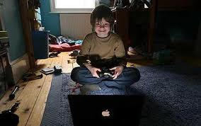
Online safety: Start now
Consider where you use technology with children – downstairs is best so that children don’t expect to use it in their bedroom
Consider how long you are happy for children to use technology for each day
Set up a family agreement and keep updating this as children get older

Slide 4
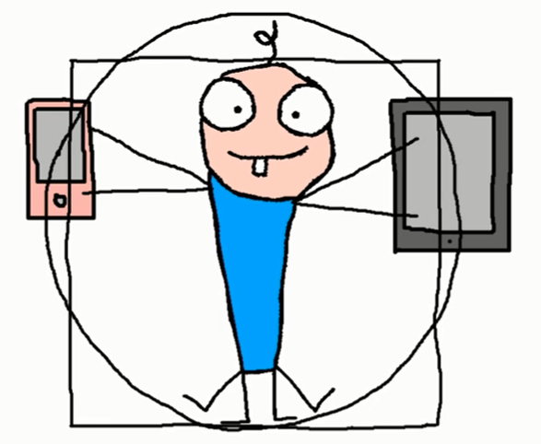
http://homotabletis.org/en/
https://www.youtube.com/watch?v=FKIDxi_ZFrg
Notes:
A video to encourage discussion about the way in which tablets and phones are used with and by children.

Slide 5
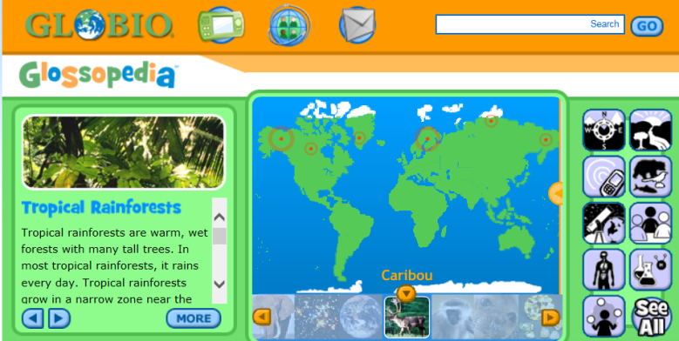
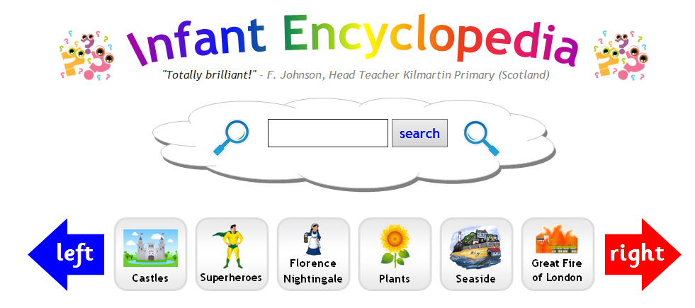
Creative, knowledgeable and fearless
Notes:
Examples of websites that can be shared with young children.
Kiddle is a safe(r) search engine which includes images to help children to recognise the information they will be accessing

Slide 6
Creative, knowledgeable and fearless
Mrs and Mr Potato Head
Finger Paint with sounds
Lego Juniors
BBC CBeebies Storytime
Kodable
Sock Puppets
Music Sparkles
Pic Collage
Magniscope
Notes:
Examples of creative / investigative and problem solving Apps that parents could use with children

Slide 7
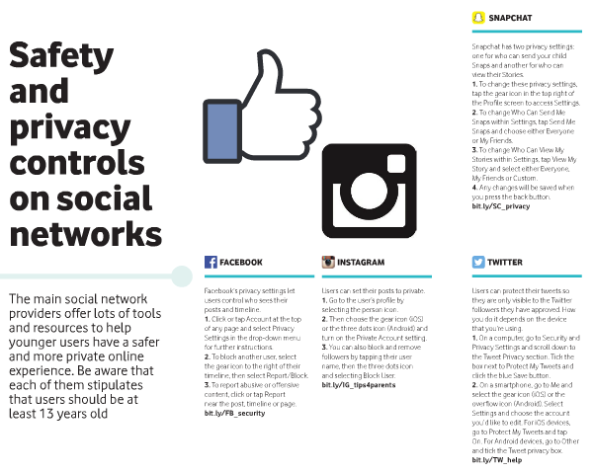
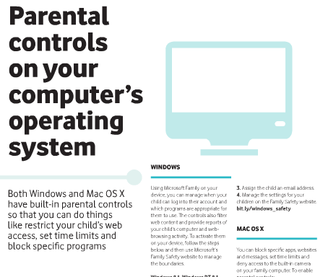
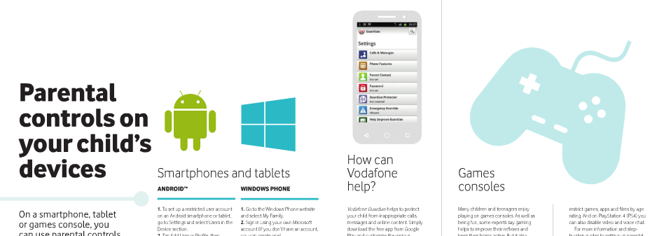
Parental Controls
Notes:
Information about parent controls can be shared with parents by copying the pages 37 - 43 of edition 4 of Vodaphone Digital parenting magazine. Vodaphone have given permission for these pages to be copied.

Slide 8
Useful Apps
Net Aware NSPCC
Information about Social Networks, Apps and Games
Internet Matters
Children and parents learning together
Notes:
Internet Matters is an App to learn about online safety together as your children get older.
Net Aware provides information about social networks, apps and games

